Slide 1
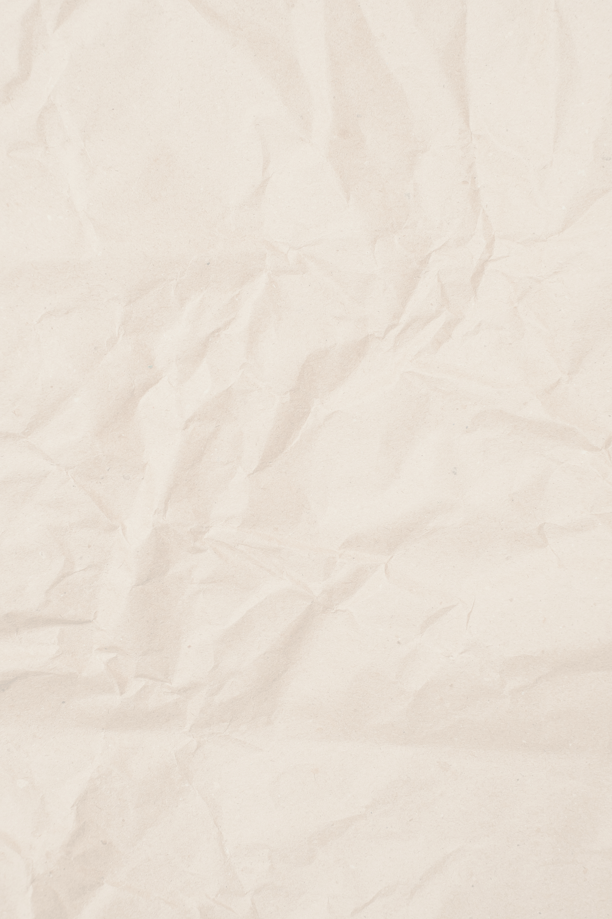
Presentation Section I
Presented by Ei Phyu Moe

Slide 2
What is Laravel?
Laravel is a PHP Framework. It helps developers build websites and web applications easily. Laravel provides clean and organized code structure. Popular for modern web development.

Slide 3
Why Use Laravel?
Built-in security features
Supports MVC Architecture

Slide 4
Laravel Installation
Step 1: Install PHP
Step 2: Install Composer
Step 3: Create Laravel Project
Step 4: Run Server

Slide 5
Laravel Folder & Understanding MVC
1
2
app/ → Application Logic
routes/ → Website Routes
resources/views/ → UI Files
database/ → Database Files
public/ → Public Assets
Model → Works with Database
View → User Interface
Controller → Handles Logic
.

Slide 6
Process
Route
Controller
View & Blade
Routes handle user requests.
Routes are written in routes/web.php
Controllers manage application logic.
Frontend UI
Blade is Laravel's template engine.

Slide 7
Database Migration
Migration manages database tables.
Run Migration:
php artisan migrate

Slide 8
Artisan Commands
Useful Commands:
php artisan serve
php artisan migrate
php artisan make:model
php artisan optimize:clear
php artisan make:controller
etc…

Slide 9
Simple Laravel FLow
User Request → Route → Controller → Model → View

Slide 10
Q&A Session

Slide 11
Thank You

